Slide 1
Community Disaster Resilience
Mpact, University of Maryland
October 22, 2014
Stephen A. Cauffman
Manager, Community Resilience Program
Materials and Structural Systems Division
Engineering Laboratory

Slide 2
What is the Problem?
Natural and man-made hazards cause an estimated $57B in average annual costs.
Superstorm Sandy caused over $65B in losses.
Large single events can cause losses exceeding $100B.
Current approach of response and rebuilding is impractical and inefficient for dealing with natural disasters.
Planning does not account for interconnected nature of buildings and infrastructure, nor for the affect on social institutions.
Changing nature of hazards is not always considered.

Slide 3
Oregon Resilience
Plan
SPUR
Hurricane Sandy
Rebuilding Strategy
45 to 81 Presidential Disaster Declarations are made every year

Slide 4
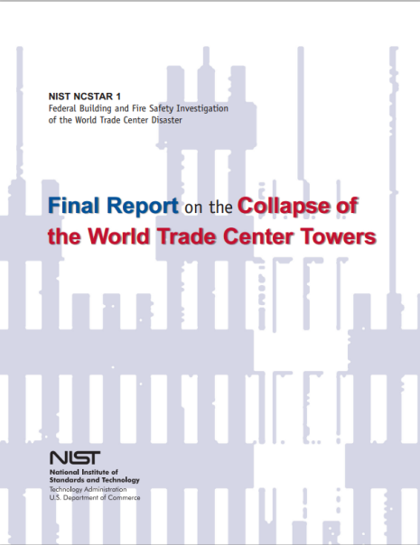
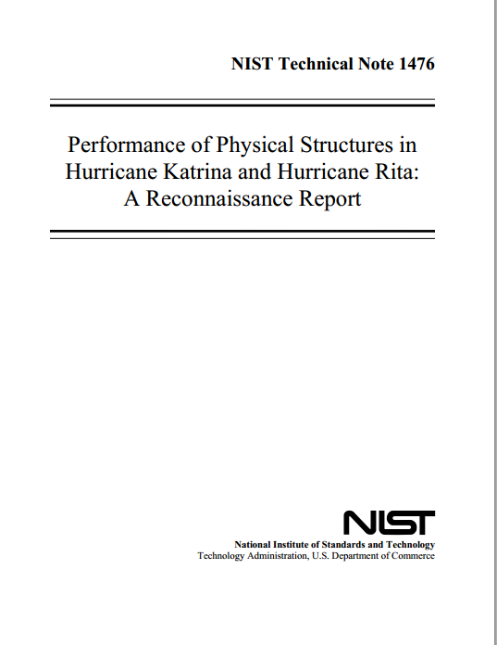
Why NIST?
NIST has a long history of conducting problem-focused research to provide the technical basis for performance-based standards and codes.
NIST has also conducted numerous studies of building failures due to natural and manmade hazards
2001 – World Trade Center Disaster
  Building collapses caused significant disruptions to power, communications, and transportation infrastructure.
  NIST conducted a major investigation of the collapses of the WTC Towers and WTC 7, with emphasis on improving building safety.
2005 – Hurricanes Katrina and Rita
  Widespread damage to buildings and infrastructure and social disruption.
  NIST conducted a study of the performance of buildings and infrastructure.
  Vulnerabilities that led to loss of function were noted in the report.

Slide 5
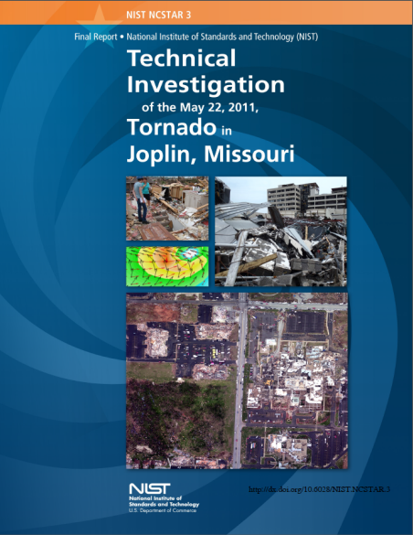
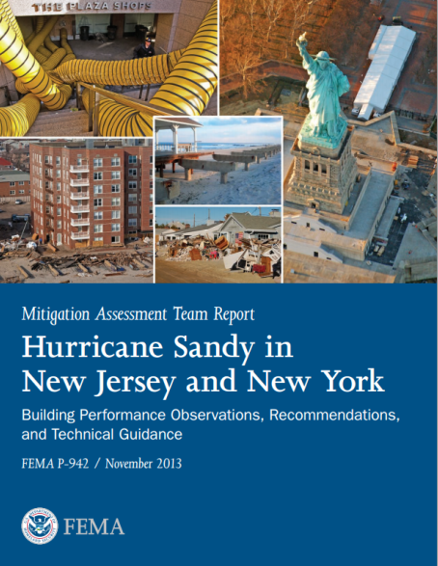
Why NIST?
2011 – Joplin Tornado
  Significant damage and loss of life due to the tornado.
  NIST conducted an investigation of the performance of buildings as well as emergency communications and looked at the interdependencies between buildings and infrastructure.
2012 – Superstorm Sandy
  Significant disruptions due not only to direct damage but also cascading effects due to interconnected nature of buildings and infrastructure.
  NIST researcher joined FEMA Mitigation Assessment Team to specifically collect data on impacts to critical facilities and infrastructure systems.

Slide 6
What is Disaster Resilience?
The term "resilience" means the ability to prepare for and adapt to changing conditions and withstand and recover rapidly from disruptions*
In the context of community resilience, the emphasis is not solely on mitigating risk, but implementing measures to ensure that the community recovers to normal, or near normal function, in a reasonable timeframe.
*As defined in Presidential Policy Directive 21.

Slide 7
What is a Community?
A community can be defined as having the following attributes:
  Clear geographical boundaries
  A governance structure able to make decisions and either implement actions or influence the actions of others
Examples of communities include, but are not limited to:
  Cities, towns, counties
  College campuses
  Military bases
Some systems (e.g., electric power) often extend beyond the boundaries of the community.

Slide 8
Resilience Concept
  Maintain acceptable levels of functionality during and after disruptive events
  Recover full functionality within a specified period of time
Functionality
Modifications before disruptive events that improve system performance
Lost
Functionality
Aging
System
Repairs after disruptive event to restore system functionality
Residual
Functionality
Event
Time
Time to Full Recovery
Adapted from Bruneau, 2003 and McDaniels, 2008

Slide 9


Community Needs Drive Functional Requirements for Buildings and Infrastructure
Energy
Transportation
Government
Citizens
Functional
Requirements
Communications
Structures
Business
Industry
Water

Slide 10



Community Resilience for the Built Environment
Natural hazards
Manmade hazards
Degradation
Climate change
Performance
Goals
Mitigation
Response
Recovery

Slide 11
Attributes of Resilience
Functionality – Resilience should be based on the ability of social systems to resume function within a prescribed period of time following an expected event. Buildings and infrastructure must be functional to support these social systems.
Interdependence – Resilience must consider the interdependence of buildings and infrastructure (functionality) and the relationship of individuals and organizations with the built environment.

Slide 12
Attributes of Resilience (Cont.)
Three levels of hazard
  Routine
  Expected (design level)
  Extreme
Time basis – Resilient performance will require a timescale for when buildings and infrastructure need to be returned to service to meet social needs.

Slide 13
Performance Levels for After-Event Evaluation
Category | Buildings Performance Standard
A | Safe and Operational Essential facilities such as hospitals and emergency operations centers
B | Safe and usable during repair “Shelter in place” residential buildings, neighborhood businesses and services, and buildings needed for emergency operations
C | Safe and not usable The minimum needed to save lives. These facilities may be repaired or needed to restore the economy.
D | Unsafe – partial or complete collapse Damage that will lead to casualties

Slide 14
Performance Levels for After-Event Evaluations
Category | Infrastructure System Performance Standard
I | Resume 100% service within days
II | Resume 90% service within weeks and 100% within months
III | Resume 90% service within months and 100% within years

Slide 15
NIST Community Resilience Program
NIST is:
Convening the highly diverse stakeholder interests to:
  Develop the first version of a comprehensive Disaster Resilience Framework for achieving community resilience that considers the interdependence of the community's physical and human assets, operations, and policies/regulations
  Establish a Disaster Resilience Standards Panel to further develop the Disaster Resilience Framework (version 2.0) and,
  Develop Model Resilience Guidelines for critical buildings and infrastructure systems essential to community resilience based on model standards, codes, and best practices
The Disaster Resilience Framework Version 1.0, formation of the Disaster Resilience Standards Panel, and Model Resilience Guidelines are called out in the President’s Climate Action Plan

Slide 16
Framework Development Process
July 2014 Workshop
25% Draft
October 2014 Workshop
50% Draft
January 2015 Workshop
75% Draft
April 2015 Workshop
Release Draft for Public Comment
Disaster Resilience Framework Version 1.0

Slide 17
Disaster Resilience Fellows
The Disaster Resilience Fellows Program will augment expertise currently existing on the NIST team in the following areas:
  State and local governance
  Urban planning
  Lifeline sectors (electric power, water/wastewater, transportation, communications)
  Insurance/Re-insurance
  Emergency planning and response
  Sociology of disasters
  Economic resilience
  Business continuity
First year of program will support the development of the Disaster Resilience Framework
Second year will support both the Disaster Resilience Framework and DRSP as well as the research component of the program

Slide 18
Community Resilience R&D Community Resilience Assessment
Develop first-generation tools to assess resilience at the community scale.
Identify the systems (physical and social), attributes, and interdependencies that must be considered.
Conduct pilot studies using the first-generation tool to inform development of community resilience models, identify gaps, and inform the development of a second-generation methodology.

Slide 19
Community Resilience R&D
Economic Analysis Tools
Develop a first-generation economic analysis tools to facilitate cost-effective resource allocations that minimize the economic burden of disasters on communities.
Develop draft standard practices and submit to ASTM.
Economic Analysis tools, combined with the Resilience Assessment tools, will provide decision makers at the community/regional level a means to evaluate alternate investment decisions.

Slide 20
Community Resilience R&D
Systems Modeling
Develop systems-based methods and models for assessing community resilience to provide the science basis for community resilience assessment and decision-support methodologies.
Include the interdependencies among buildings, infrastructure, and the social systems that they support.
Develop a conceptual model to explain long-term disaster recovery decisions by the public.

Slide 21
Concluding Remarks
Improving resilience does not have to be prohibitively expensive
Measures to improve resilience can be implemented over many years
The Disaster Resilience Framework will help communities with prioritizing buildings and infrastructure and with planning to improve resilience
Model Resilience Guidelines will provide guidance in the form of standards, codes, and best practices, to implement resilience measures
Resilience assessment tools and economics-based decision support tools will aid communities aid communities with identifying needs and prioritizing actions

Slide 22
NIST Contacts
Mr. Stephen Cauffman
Manager, Community Resilience Program
E-Mail: stephen.cauffman@nist.gov
Phone: 301-975-6051
Website: http://www.nist.gov/el/building_materials/resilience/
General E-mail: resilience@nist.gov

